Slide 1
Intermediate Python – Mar 22
Agenda
Software Accessibility Presentations
Arjun (Today)
Module B.3: Intermediate Python Programming
Console Input
Tic-Tac-Toe Game
Module A.3: Dream Machine
Continue to Work On: Level 1 & Level 2
Upcoming
Tomorrow : Continue Mod A.3

Slide 2
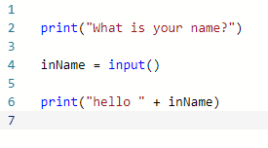
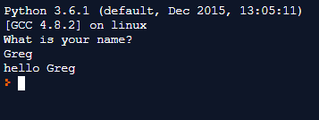
Python Input

